Slide 1
Flashcards
Cool Tips and Quick Tricks for Using Microsoft Unified Communications

Slide 2


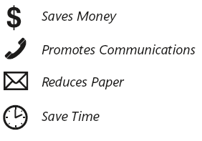

How to use your Unified Communications Cards
This deck of cards can help you get things done. Each card provides step-by-step instructions for how to use your company’s unified communications software and technology.
Category Color
Find the instructions you need to master specific tasks for the following categories.
At-a-Glance Benefits
Know immediately how each task can help you work effectively.
Messaging
Instant Messaging
Conferencing
Software-Powered Voice
Visual Guidelines
Illustrations highlight key elements of the user interface

Slide 3
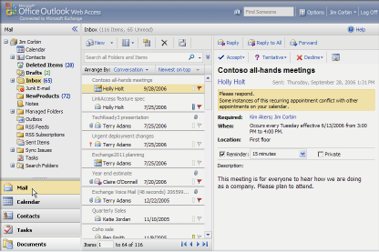
What is Outlook Web Access?
Microsoft® Office Outlook® Web Access (OWA) enables security enhanced access to your corporate e-mail over the Web using any computer or device with Internet access. OWA is a full-featured Web application that provides an experience similar to Microsoft Office Outlook 2007.
Visit www.microsoft.com/exchange/code/OWA for more information.

Slide 4

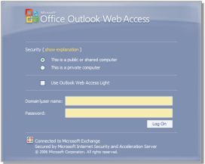
Getting started with Outlook Web Access
Signing in
To open the Microsoft® Office Outlook® Web Access (OWA) interface, type the URL address obtained from your Microsoft Exchange Server administrator into your browser address line and press ENTER.
Enter your password, and then click Log On.
If you have a dial-up connection, or if you have accessibility needs, select the Use Outlook Web Access Light check box.
Notes
• OWA Access Light provides a faster logon experience for slow connections. This version is designed for users with accessibility needs (such as those using screen readers).
• Non–Windows® Internet Explorer® browsers, and Internet Explorer 6 or earlier, automatically receive Access Light.

Slide 5

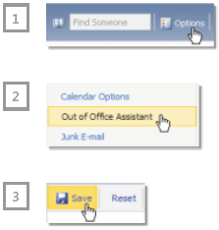
Using the Out of Office Assistant
Send or update automatic responses in Microsoft® Office Outlook® Web Access (OWA) when you are out of the office.
On the OWA toolbar, click Options.
In the Options navigation pane, click Out of Office Assistant.
In the Out of Office Assistant window, click Send Out of Office auto-replies, and then do one of the following:
• To create an auto-reply for immediate use, type a message in the text box provided.
• To create an auto-reply for a particular period of time, select the Send Out of Office auto-replies only during this time period check box, pick a start time and end time, and then type a message in the text box provided.
4. This creates an auto-reply for senders inside Microsoft.
5. To create an additional auto-reply for senders outside Microsoft, select the Send Out of Office auto-replies to External Senders check box, click an option, and then type a message in the text box provided.
6. When you have finished, at the top of the window, click Save. To exit the Options page, click a button at the bottom of the navigation pane. Your auto-reply will be sent to incoming messages—one reply to each sender—until you turn off the Out of Office Assistant, or until the end of your selected time period.

Slide 6


Outlook® Web
Access, view your messages by conversation. This groups all your e-mail
into message “threads.”
• In Mail view, click the Arrange By bar near the top of the Inbox,
and then click Conversation.
Each conversation group is marked with a plus sign . Click the to see
all the messages in the conversation.
Use Conversation view to group messages
To find all replies to a single message in Microsoft® Office Outlook® Web Access, view your messages by conversation. This groups all your e-mail into message “threads.”
• In Mail view, click the Arrange By bar near the top of the Inbox, and then click Conversation.
Each conversation group is marked with a plus sign . Click the to see all the messages in the conversation.

Slide 7



Outlook® Web
Access, view your messages by conversation. This groups all your e-mail
into message “threads.”
• In Mail view, click the Arrange By bar near the top of the Inbox,
and then click Conversation.
Each conversation group is marked with a plus sign . Click the to see
all the messages in the conversation.
Search messages by key word
In Microsoft® Office Outlook Web Access (OWA), use Search to quickly find messages or other mail items that contain one or more specific words. You can do a full-text search for specific words on items in Mail, Contacts, and Tasks.
Type one or more words in the box near the top of the middle pane.
• To specify which folders to search, click at the end of the Search box.
• To see Advanced Search options, click at the end of the Search box.
Click ,or press ENTER.
Search results appear in the main window. To clear the results list and begin a new search, click .

Slide 8


Outlook® Web
Access, view your messages by conversation. This groups all your e-mail
into message “threads.”
• In Mail view, click the Arrange By bar near the top of the Inbox,
and then click Conversation.
Each conversation group is marked with a plus sign . Click the to see
all the messages in the conversation.
Reset your UM voice mail PIN
If you have Microsoft® Exchange Server 2007 Unified Messaging (UM), you can use Microsoft Office Outlook® Web Access (OWA) to reset your voice mail PIN.
On the OWA toolbar, click Options.
In the Options navigation pane, click Voice Mail.
In the main window, under Reset Voice Mail PIN, click Reset Voice Mail PIN.
In the Reset Voice Mail PIN box, click OK.
A new temporary UM Voice Mail PIN will be sent to you via e-mail. Use it to access your voice mail on your phone and change the PIN to a new permanent one.

Slide 9
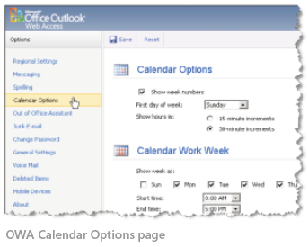
Outlook® Web
Access, view your messages by conversation. This groups all your e-mail
into message “threads.”
• In Mail view, click the Arrange By bar near the top of the Inbox,
and then click Conversation.
Each conversation group is marked with a plus sign . Click the to see
all the messages in the conversation.
Customize your OWA
Microsoft® Office Outlook® Web Access (OWA) offers many options found in Microsoft Office Outlook 2007. Use the Options page to customize OWA. The table at right lists some of the most-used options in OWA.
On the OWA toolbar, click Options.
In the Options navigation pane, click a category. In the main window, choose settings for that category.
When you have finished, at the top of the window, click Save. To exit the Options page, click the Mail button at the bottom of the navigation pane.

Slide 10
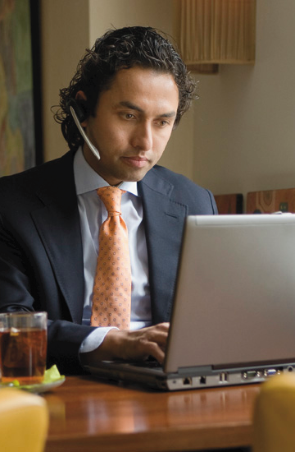

Outlook® Web
Access, view your messages by conversation. This groups all your e-mail
into message “threads.”
• In Mail view, click the Arrange By bar near the top of the Inbox,
and then click Conversation.
Each conversation group is marked with a plus sign . Click the to see
all the messages in the conversation.
Remotely wipe all mobile device data
Any of your mobile devices that have an Exchange partnership automatically appear in your Microsoft® Office Outlook® Web Access (OWA) Mobile Devices list. In the event of loss or theft, you can use OWA to wipe all data from such a device.
On the OWA toolbar, click Options.
In the Options navigation pane, click Mobile Devices.
In the main window, click the device you want to wipe.
Click Wipe All Data from Device.
OWA sends a command to the device that wipes all data on it. If the device is turned off when the device wipe command is sent, the command is initiated when the device is turned on again and the first synchronization occurs.

Slide 11

Spelling checker—don’t e-mail without it
• By popular demand, Microsoft® Office Outlook® Web Access (OWA) can now check spelling! The following languages are currently supported: English, French, German, Italian, Korean, and Spanish. The first time you click Spelling, you will be prompted to select your preferred language.
• OWA spelling checker does not have capability to add new words to the dictionary.
• On replies and forwarded messages, spelling checker checks only the new text—not the text of the original message.
Note: You can use OWA spelling checker in two ways: (1) Manually, by clicking the Spelling button when you want to check spelling or (2) Automatically, by going to Options and selecting the Always check spelling before sending check box. This prompts the spelling checker to open whenever you click Send.

Slide 12

Message Flagging—manage your list
With Microsoft® Office Outlook® Web Access (OWA), you can flag messages for follow-up in multiple colors and settings. Message Flagging helps you organize your work by providing a visual indicator of which items in the mailbox need further action.
The new flag column, to the right of the message list, is where you flag a message, mark a flag as complete, or clear a flag.
• To flag a message, right-click the Message Flagging column and select the flag you want to apply.

Slide 13
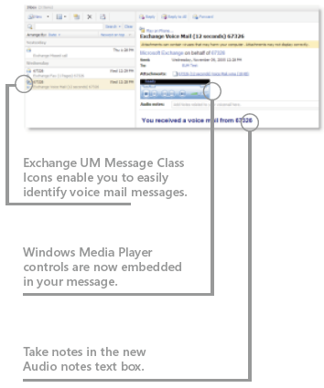
What is Unified Messaging (UM)?
Microsoft® Exchange Server 2007 Unified Messaging (UM) integrates e-mail and voice mail services. UM enables you to check calendar events and listen and reply to e-mail through the telephone.
Benefits:
• Exchange mailbox access with internet access
• Enhanced productivity
• Check Exchange data anytime by telephone
• Listen to and archive voice mail messages on your laptop
• Receive voice mail messages via computer or telephone
• Use Microsoft Office Outlook® Voice Access to “call” a contact
• Check and update your Calendar by telephone
• Send a message to meeting attendees by telephone
• Check on meeting room and location using your telephone
• Apply e-mail productivity features such as Message Flagging and Categories to voice mail and fax messages

Slide 14

Outlook® Web
Access, view your messages by conversation. This groups all your e-mail
into message “threads.”
• In Mail view, click the Arrange By bar near the top of the Inbox,
and then click Conversation.
Each conversation group is marked with a plus sign . Click the to see
all the messages in the conversation.
Establish your personal voice mail settings
When your voice mail has been migrated to the Microsoft® Exchange Server 2007 Unified Messaging platform, you’ll receive an e-mail message containing a temporary Personal Identification Number (PIN) and log on instructions. It’s important that you perform the following steps in accordance with those instructions.
Use the instructions in your e-mail message to log on to Exchange Unified Messaging with your temporary PIN.
Create a new personalized PIN.
Enter your personal settings by following the voice prompts.
Note: To meet new security standards, your PIN must be eight digits or more; you must establish a new PIN every 70 days; and if you have five consecutive login failures, you will be locked out.

Slide 15
Outlook® Web
Access, view your messages by conversation. This groups all your e-mail
into message “threads.”
• In Mail view, click the Arrange By bar near the top of the Inbox,
and then click Conversation.
Each conversation group is marked with a plus sign . Click the to see
all the messages in the conversation.
Reset your Unified Messaging PIN
For security reasons, you need to reset your PIN after each cycle of 70 days. To reset your PIN using your telephone:
Log on to Microsoft® Exchange Server 2007 Unified Messaging by following the instructions in your welcoming
e-mail message.
Press 6 to select Personal Options.
Press 3 to Change PIN.
To reset your PIN using Microsoft Office Outlook® Web Access (OWA):
Log on to OWA.
On the Options page, click Voice Mail.
Click Reset Voice Mail PIN.
In the Reset Voice Mail PIN message, click OK. You will be sent an e-mail message with a temporary PIN.
To reset your PIN using Microsoft Office Outlook 2007:
• In Outlook Options, under the Tools menu, choose the Voice Mail tab, and then select Reset PIN. You will be sent an e-mail message with a temporary PIN.

Slide 16
Outlook® Web
Access, view your messages by conversation. This groups all your e-mail
into message “threads.”
• In Mail view, click the Arrange By bar near the top of the Inbox,
and then click Conversation.
Each conversation group is marked with a plus sign . Click the to see
all the messages in the conversation.
Check your voice mail messages
Microsoft® Exchange Server 2007 Unified Messaging will route all voice mail messages coming to your office telephone directly to your e-mail inbox. Listen to your office voice mail messages on the phone or via your computer with Microsoft Office Outlook® or Microsoft Office Outlook Web Access (OWA).
Listen to your office voice mail messages by telephone
Dial in to the access number provided to you, and then enter your PIN.
Say “voice message” or switch to touchtone input, and then press 1 to hear your voice mail messages played for you.
Listen to your office voice mail messages on your computer
Using Outlook or OWA, open your voice mail message in your inbox.
Click the Play icon on the embedded Windows Media Player.
Note: The Exchange Server Unified Messaging voice mail menu’s default navigation is voice; if you want to navigate by touch tone, press 0.
TIP: Take notes on the voice mail message by typing in the Audio notes text box. Click anywhere outside the text box to save.

Slide 17

Outlook® Web
Access, view your messages by conversation. This groups all your e-mail
into message “threads.”
• In Mail view, click the Arrange By bar near the top of the Inbox,
and then click Conversation.
Each conversation group is marked with a plus sign . Click the to see
all the messages in the conversation.
Check your e-mail by telephone
Microsoft® Exchange Server 2007 Unified Messaging provides an enhanced number of commands to help you manage your e-mail by telephone. This procedure does not reflect all of the possible options
available.
Dial the access number provided to you, and enter your PIN.
Say “e-mail,” or press 0 to switch to touch tone and then press 2 to hear your e-mail messages.
Choose an optional response from the information provided. This may include Delete, Reply, Forward, or Next.

Slide 18
Outlook® Web
Access, view your messages by conversation. This groups all your e-mail
into message “threads.”
• In Mail view, click the Arrange By bar near the top of the Inbox,
and then click Conversation.
Each conversation group is marked with a plus sign . Click the to see
all the messages in the conversation.
Check your calendar by telephone
Check your Microsoft® Office Outlook® calendar from your telephone. Get your daily meeting schedule, accept or decline meeting invitations, clear your schedule, or announce that you’ll be late—all from your telephone.
Dial your access number, and then enter your PIN.
Say “calendar for today” or press 0 to switch to touchtone, and then press 3 to select Calendar Options.
Microsoft Exchange Server 2007 Unified Messaging announces your calendar entries for the day, as well as any meeting requests that are pending.
At any time while listening to the Appointments list, say “next”, “previous”, “repeat”, “more options”, or “main menu”, as appropriate.
At any time while listening to Meeting Details, say “faster”, “slower”, “rewind”, or “fast forward” (which will jump to the next message), as appropriate.
Note: For touchtone use:
• To accept a meeting request, press 4.
• To decline a meeting request, press 7.
• To find out who is attending a scheduled meeting, press 55.
• To announce that you’ll be late, press 6.

Slide 19
Outlook® Web
Access, view your messages by conversation. This groups all your e-mail
into message “threads.”
• In Mail view, click the Arrange By bar near the top of the Inbox,
and then click Conversation.
Each conversation group is marked with a plus sign . Click the to see
all the messages in the conversation.
Search the Global Address List
With Microsoft® Exchange Server 2007 Unified Messaging, you can access the Global Address List (GAL) by telephone to search for contact
information.
Dial your access number, and then enter your PIN.
Say “directory”, and then follow the voice prompts to search the Global Address List to find your desired contact.
If you want to call the contact, say “call the office” to call the user directly.

Slide 20
Outlook® Web
Access, view your messages by conversation. This groups all your e-mail
into message “threads.”
• In Mail view, click the Arrange By bar near the top of the Inbox,
and then click Conversation.
Each conversation group is marked with a plus sign . Click the to see
all the messages in the conversation.
Set your Out of Office message
Use Microsoft® Exchange Server 2007 Unified Messaging to set an Out of Office voice mail greeting by telephone while you’re away.
Dial your access number, enter your PIN, then press 0.
At the Main Menu, press 6 for Personal Options.
Press 1 to activate your Out of Office message.
To change the Out of Office recording, press 1.

Slide 21
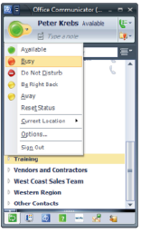
Manage your IM presence status
When you’re using instant messaging (IM) in Microsoft® Office
Communicator 2007, display your availability with presence status.
When you need to focus on high-priority tasks, set your IM status to Busy to let coworkers know that you are not available for an IM conversation at the time.
When you or a contact is on the phone, your status is automatically set to Busy and your presence status shows as In a call. You can send an IM to a contact in a call, but the contact may be slow to respond or may not respond at all.
If you absolutely cannot be disturbed (for example, during a presentation), you can set your status to Do Not Disturb. However, use Do Not Disturb sparingly because always appearing as Do Not Disturb is similar to not answering your phone or e-mail.
If you will be away or in training, it’s a best practice to leave a note where you are. Click the Type a note box to leave a note.

Slide 22







Presence and incoming calls
If your IM presence is: | Your state is: | An incoming call:
 | Available | Rings on all devices running Microsoft® Office Communicator 2007, and a call alert appears on your computer. If the call is not answered, it defaults to Voice Mail.
 | Inactive | Rings on all devices that are running Communicator, and a call alert appears on your computer. If the call is not answered, it defaults to Voice Mail.
 | Busy (Inactive) | Rings on all devices that are running Communicator, and a call alert appears on your computer. If the call is not answered, it defaults to Voice Mail.
 | Busy (In a Meeting or In a Call) | Rings on all devices that are running Communicator, and a call alert appears on your computer. If the call is not answered, it defaults to Voice Mail. If you accept an incoming call while you are on the phone, the current call is put on hold. Click the Resume button to return to the original call.
 | Do Not Disturb | Goes to Voice Mail. However, calls from contacts at the Team access level ring all devices that are running Communicator, and a call alert appears on your computer.
 | Away | Rings on all devices that are running Communicator and a call alert appears on your computer. If not answered, the call defaults to Voice Mail.
 | Offline | By default, all incoming calls go to Voice Mail.

Slide 23

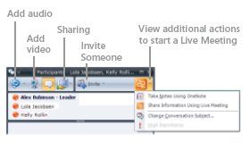
Add voice or video to an IM session
With Microsoft® Office Communicator 2007, you can add communication modes to your conferencing session. For example, you can start an instant messaging (IM) conversation with a single contact, add more contacts for an IM conference, and then add audio and video. If you need to share data, applications, or slides, you can share your desktop or escalate to a Microsoft Office Live Meeting session—without having to re-invite participants.
Turn an IM conversation into a conference
During an IM session, click Invite, click Invite Someone, and then select the contacts you want to invite to the conference.
Turn an IM conference into a phone or AV conference
During an IM conference, click Add Audio to add audio to the conference, or click Add Video to add video to the conference.
Turn a phone or AV conference into a
Live Meeting
During a conference call, click the arrow to the right of the Additional Actions button, and then click Share Information Using Live Meeting or Meet Now Using Live Meeting Service. (These options are only available if Live Meeting is installed.)

Slide 24
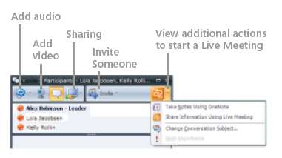
Share your desktop in an IM session
During an instant messaging (IM) conversation, you can share your desktop or share information using Microsoft® Office Live Meeting.
To allow other participants to view your entire computer desktop during a conversation or IM, click the Sharing button, and then click Share Desktop.
To share control so that another participant can provide mouse and keyboard input to your desktop, in the Conversation window, click the arrow next to the Sharing button, and then click Share Control with Participants. The other participants will see a Take Control button, which they can click to control the applications on your desktop.
You typically use Share Information Using Live Meeting if all of your conference participants are internal, such as peer employees and federated partners. Common scenarios include conferences with team members and strategy meetings with partners. Use Meet Now Using Live Meeting Service if your conference includes external users, such as clients and personal contacts, as in sales calls and customer training sessions.

Slide 25
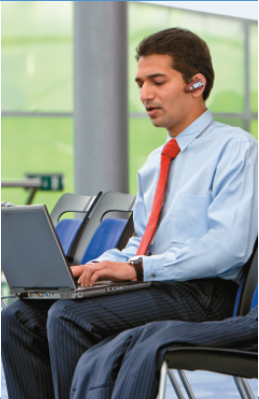

Answering a phone call with IM
When you’re using Microsoft® Office Communicator 2007, you can redirect a phone call to an instant message (IM) when you’re in a meeting.
Select the Redirect button, click Send an Instant Message, enter a message, and then press ENTER.

Slide 26
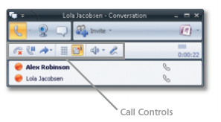
Call Controls in Communicator
In Microsoft® Office Communicator 2007, Call Controls enable you to easily manage your phone calls. For example, you can put a call on hold, transfer a call to another user or phone, mute a speaker or microphone, or end a call.
End a call
In the Conversation window, click the End Call button.
Put a call on hold
• In the Conversation window, click the Hold button.
Transfer an incoming call to another person
• Click the call alert invitation to accept the call. In the Conversation window, click the Transfer button, click Transfer, and then select the contact to whom you want to transfer the call.
Muting a speaker or microphone
• To mute or un-mute audio, click the Mute Speakers or Mute Microphone button as appropriate. The call continues normally without being placed on hold.
To mute your microphone during a conference call, click the Conference Call button, and then click Mute My Line. Others on the conference call see your audio as muted in the Participant List.

Slide 27

Publish your phone numbers
In Microsoft® Office Communicator 2007, you can edit your phone numbers and then publish them if you want them to be available to other users.
Edit and publish your phone numbers
In the Communicator Title bar, click the Menu button, point to Tools, click Options, and then click Phones. Click the button for the number you want to add or edit. After you have entered the number, select the Publish this phone number box for the numbers that you want to make visible to other Communicator users.
About phone number formats When specifying phone numbers, enter the country code, an area code, and the local number, using only the digits 0123456789. Do not use alphanumeric numbers. Thus, a U.S. number might look like: 14255550101. See your system administrator for dialing requirements (such as adding 9 for outside calls) that may be specific to your organization.

Slide 28
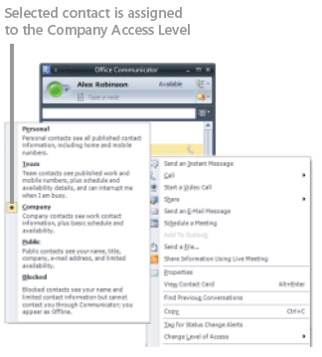
Control access to your phone numbers
You can assign levels of access to your contacts to control their access to your presence information. Different attributes are exposed for each presence level, such as Block, Public, Company, Team, and Personal. For example, Mobile Phone is available at the Team Level, but not at the Company Level.
Control access to your phone numbers
• After you publish your phone numbers, you must assign Access Levels to contacts whom you want to see your phone numbers. If you want a contact to see your Home and Mobile phone numbers, assign the contact to the Personal Level. If you want them to see only your Work and Mobile numbers, assign them to the Team Level. To assign a contact to an Access Level, right-click the contact, point to Change Level of Access, and then select the Access Level.

Slide 29
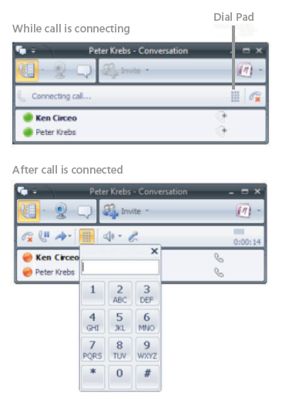
Where is the Communicator dial pad?
With voice mail systems or conference calls, you are often asked to either enter a PIN or make a selection by entering a number. To do this, you need to either enter numbers from your phone dial pad or the dial pad in Microsoft® Office Communicator 2007. If you are voice-enabled, the dial pad is available to you during and after the connection. While a call is being connected, the dial pad is available in the Call Control area of the Conversation window, as shown in the illustration.
After the call is connected, the dial pad is available in the Call Control area, as shown in the illustration.

Slide 30
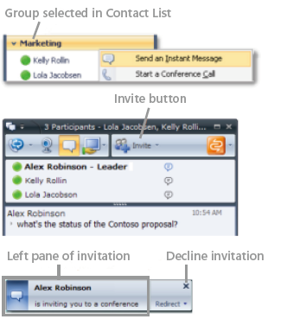
Start and join an IM conference
Start an IM conference
• You can select multiple contacts or a group in your Contact List to start an instant messaging (IM) conference. You can also escalate a one-to-one IM session to a group conference by simply inviting other contacts to an IM session.
Start an IM conference with multiple contacts
• In the Contact List, hold the CTRL key, and then select the contacts you want to invite. Right-click the last contact, and then click Send an Instant Message. Type your message in the Message Entry box, and then press ENTER.
Start an IM conference with a group
• In the Contact List, right-click a group name, and then click Send an Instant Message. Type your message in the Message Entry box, and then press ENTER.
Invite someone to an IM session or conference
• In the Conversation window, click Invite, and then select the contacts you want to invite.
Join an IM conference
• In the conference invitation alert, click the left pane. The alert appears in the bottom right of your computer screen.

Slide 31
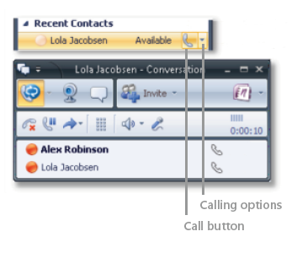
Make a phone call with Communicator
You can use Microsoft® Office Communicator 2007 to make one-click phone calls to contacts in your Contact List. You can also call optional numbers by clicking the options arrow to the right of the Call button.
Make a one-click phone call
• In the Contact List, click the contact’s Call button.
Call an alternate phone number
• In the Contact List, click the arrow to the right of the Call button, and then click the number you want to call.
Enter a phone number to call
• Type the number in the Search box, and then click the Call button next to the number as it appears in the Search Results box. You can enter an internal phone extension, an external number, an alphanumeric number such as 425-555-TAXI, or a contact’s name.
Invite someone to a call
• In the Conversation window, click the Invite button, and then select a contact, enter a name, or enter a number to call.

Slide 32
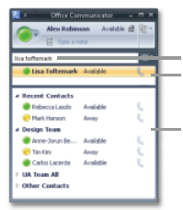
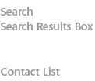
Manage your contacts and Contact List
Your Contact List is a list of coworkers, family, and friends with whom you communicate most often. When you first install Microsoft® Office Communicator 2007, you must build your Contact List.
Search for someone
• Type a person’s name or e-mail address in the Search box.
Add a person or distribution group to your Contact List
• Type the person or distribution group’s name in the Search box, and then drag the name from the Search Results box to the Contact List.
Add a contact outside your company
• To add a public instant messaging (IM) contact from AOL, Yahoo Messenger, MSN Messenger, or Windows Live Messenger Service, or a federated contact (a contact whose company is federated with your company), type the person’s e-mail address in the Search box, and then drag the name from the Search Results box to the Contact List. (To add a public IM contact, your organization must be configured for public IM connectivity. Contact your system administrator for more information.)
View a contact’s Contact Card
• Click the contact’s Presence button.
Create a custom group
• In the Contact List, right-click a group name, select Create New Group, type a name for the group, and then press ENTER. To add contacts to the group, drag them from an existing group or from the Search Results box.

Slide 33

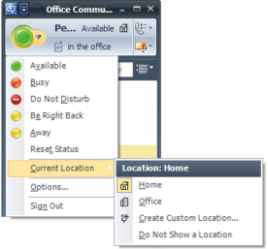
Set your Location in Communicator
Location must be set manually for each device that is running Microsoft® Office Communicator 2007. To set your Location, click your Presence button, click Current Location, and then select a Location or select Create a Custom Location. Contacts with a Team or Personal access level will see the location from the most recently active device that is running Communicator.

Slide 34


Instant messaging etiquette
Before sending an instant message (IM), check the person’s presence status.
• If the contact’s presence status is Available (the presence icon is green), the contact is available for a conversation.
• If a contact’s presence status is set to Busy, refrain from sending a message unless it’s urgent.
• If a contact’s presence status is In a Call, they may be slow to respond or may not respond at all.
• If a contact’s status is set to Do Not Disturb, do not send a message unless it’s an emergency.
• If you are initiating the IM, your first message should state the topic and ask the other person if they have time to IM with you (“Got a moment to discuss the Contoso account?”). This may not be necessary with someone you work with frequently and when the question is quick and simple (e.g., “Are you going to join us for the meeting?”).
Don’t take offense if your contact doesn’t respond immediately as contact may be unable to do so, even if the contact’s presence status is Available. Assume the contact will respond when free. Avoid messaging someone repeatedly when you don’t get a response.
• If you receive a terse IM response (“In a meeting—talk later”), do not be offended. While this may be considered a rude response in person, it is a perfectly acceptable way for a contact to let you know they’re unavailable for IM conversation at the time.

Slide 35
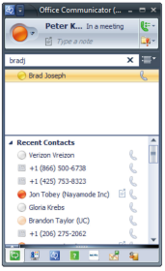
Contact List etiquette
Basic etiquette can help you manage your Contact List in Microsoft® Office Communicator 2007.
• If someone adds you to their Contact List, you are not obligated to add them to your Contact List. You can gently decline by checking the button and clicking OK.
• You don’t need permission to add someone to your Contact List. However, by default, the person you add to your Contact List receives an alert that you have added him or her to your list.

Slide 36
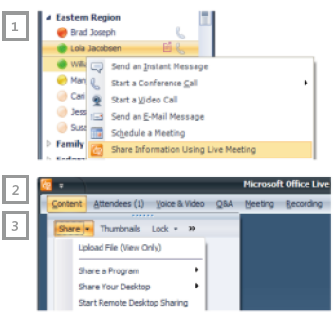
Start internal meetings with Communicator
Start a Live Meeting with Microsoft® Office Communicator 2007
Press and hold the CTRL key to select the people in the Communicator Contact List that you want to invite. Right-click one of the contacts and then click Share Information Using Live Meeting.
Microsoft Office Live Meeting opens. At the same time, Communicator sends an application-sharing invitation to your selected contacts.
In Live Meeting, you can start an application-sharing session at any time. To start application-sharing, click Share, and then select the option you want.
Typically, you’d pick up the phone and dial your conference call number to start the audio portion of the meeting (if you are meeting with only one person, you can simply call his or her number). However, if you’re using computer audio, a separate telephone call is not required.
TIP: If you want to invite additional people to the meeting after it starts, in the Live Meeting window, click Meeting, click Invite, click By E-mail, enter the e-mail addresses of the people you want to invite in the To line, and then click Send.

Slide 37
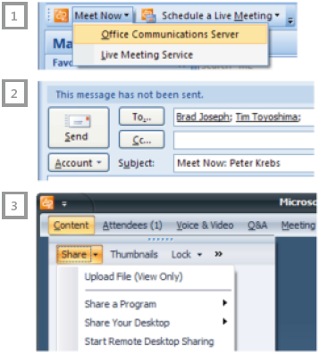
TIP: If you want to invite additional people to the meeting after it starts, in the Live Meeting window, click Meeting, click Invite, click By E-mail,
Start internal meetings using plug-in
Start a Live Meeting from the Outlook Conferencing plug-in
Open Microsoft® Office Outlook® 2007, and then on the Outlook Conferencing toolbar, click Meet Now, and then click Office Communications Server.
An Outlook Meet Now invitation window appears and Microsoft Office Live Meeting opens in the background. In the Meet Now invitation window, in the To box, enter the e-mail addresses of the people you want to invite, and then click Send.
In Live Meeting, you can start an application-sharing session at any time. To start application-sharing, click Share, and then select the option you want.
Typically, you’d pick up the phone and dial your conference call number to start the audio portion of the meeting (if you are meeting with only one person, you can simply call his or her number). However, if you’re using computer audio, a separate telephone call is not required.
TIP: If you want to invite additional people to the meeting after it starts, in the Live Meeting window, click Meeting, click Invite, click By E-mail, enter the e-mail addresses of the people you want to invite in the To line, and then click Send.

Slide 38
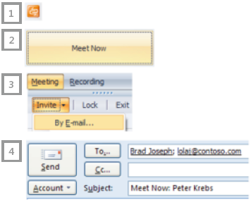
TIP: If you want to invite additional people to the meeting after it starts, in the Live Meeting window, click Meeting, click Invite, click By E-mail,
Start internal meetings from taskbar
Start a Live Meeting from the Windows® taskbar
On your Windows taskbar, click the Live Meeting icon.
Click the Meet Now button.
In the Microsoft® Office Live Meeting window, click Meeting, click Invite, and then click By E-Mail.
In the To box in the Outlook Invitation window, type the e-mail addresses of the people you want to invite or click the To button to select attendees, and then click Send.
Pick up the phone and dial the conference call number to complete the audio portion of the call.
To share an application or your desktop, in the Live Meeting window click Content, click Share, and then point to Share a Program or Share Your Desktop, and then select the option you want.
TIP: If you want to invite additional people to the meeting after it starts, in the Live Meeting window, click Meeting, click Invite, click By E-mail, enter the e-mail addresses of the people you want to invite in the To line, and then click Send.

Slide 39
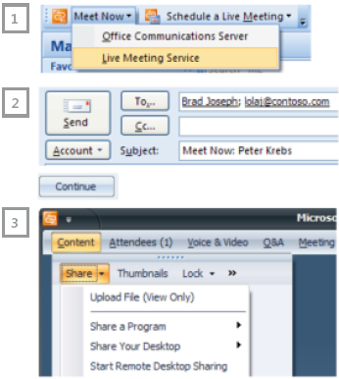
TIP: If you want to invite additional people to the meeting after it starts, in the Live Meeting window, click Meeting, click Invite, click By E-mail,
Start meetings with Live Meeting Service
Start a Live Meeting from the Outlook Conferencing plug-in—you can include people outside the company
Open Microsoft® Office Outlook®, and then on the Conferencing toolbar, click Meet Now, then click Live Meeting Service.
2. An Outlook Meet Now invitation window appears and Microsoft Office Live Meeting opens in the background. In the Meet Now invitation window, in the To box, enter the e-mail addresses of the people you want to invite, and then click Send.
3. In Live Meeting, you can start an application-sharing session at any time. To start application-sharing, click Share, and then select the option you want.
4. Typically, you’d pick up the phone and dial your conference call number to start the audio portion of the meeting (if you are meeting with only one person, you can simply call his or her number). However, if you’re using computer audio, a separate telephone call is not required.
TIP: If you want to invite additional people to the meeting after it starts, in the Live Meeting window, click Meeting, click Invite, click By E-mail, enter the e-mail addresses of the people you want to invite in the To line, and then click Send.

Slide 40
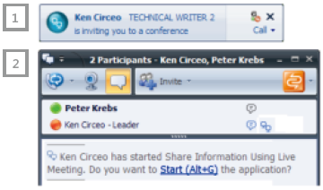
TIP: If you want to invite additional people to the meeting after it starts, in the Live Meeting window, click Meeting, click Invite, click By E-mail,
Join meetings from Communicator
Join a Live Meeting from a Share Information Invitation in Microsoft® Office Communicator 2007
When someone sends you an invitation to Share Information Using Live Meeting, you receive an alert on your desktop. Click anywhere on the left pane of the alert to accept the invitation.
If the alert fades, click the Start (ALT + G) link in the Communicator Conversation window to accept the Share Information Using Live Meeting invitation.
Microsoft Office Live Meeting opens and you have joined the Live Meeting Sharing session. Typically the person who invites you will call you directly or supply a conference call number to complete the audio portion of the Live Meeting. However, if you’re using computer audio, a separate telephone is not required.

Slide 41

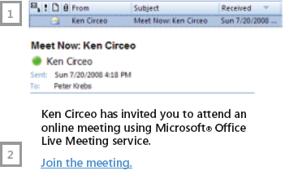
TIP: If you want to invite additional people to the meeting after it starts, in the Live Meeting window, click Meeting, click Invite, click By E-mail,
Join a Meet Now meeting from Outlook
Join a Meet Now meeting in Microsoft® Office
Live Meeting from an invitation in Microsoft Office Outlook® 2007
In your Outlook inbox, open the Meet Now invitation item.
Click the Join the Meeting link in the invitation.
Pick up the phone and dial the Conference Call number provided in the invitation. When prompted, enter your Participant Code. If you are the meeting Leader, enter your Leader Code.

Slide 42
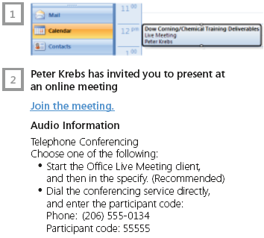
TIP: If you want to invite additional people to the meeting after it starts, in the Live Meeting window, click Meeting, click Invite, click By E-mail,
Join a Scheduled Live Meeting
Join a Scheduled Live Meeting
When someone sends you an invitation to Share Information Using Live Meeting, you receive an alert on your desktop. Click anywhere on the left pane of the alert to accept the invitation.
If the alert fades, click the Start (ALT + G) link in the Communicator Conversation window to accept the Share Information Using Live Meeting invitation.
Live Meeting opens and you have joined the Live Meeting Sharing session. Typically the person who invites you will call you directly or supply a conference call number to complete the audio portion of the Live Meeting.
TIP: When you join the meeting, you join the meeting as an Attendee, which means you cannot control a slide presentation. If you need additional privileges, ask the person who sent you the invitation to give you Presenter privileges.

Slide 43
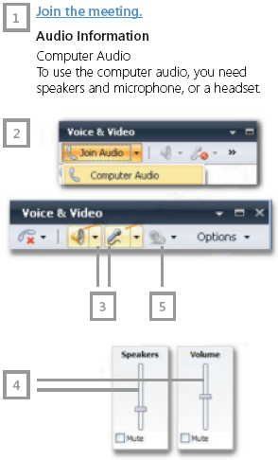
TIP: If you want to invite additional people to the meeting after it starts, in the Live Meeting window, click Meeting, click Invite, click By E-mail,
Connect to audio and video in a meeting
Join a Live Meeting from a Share Information Invitation in Microsoft® Office Communicator 2007 and connect to audio and video
From your calendar, open the meeting invitation and click the Join the Meeting link.
When you are connected to the meeting, computer audio is on by default. If it is not on, in the Voice & Video pane, click Join Audio.
To mute the speakers or microphone, in the Voice & Video pane, click the Mute Microphone or Mute Speakers icon.
To modify the speaker or microphone volume, in the Voice & Video pane, click the Microphone or Speaker drop-down and move the volume slider up or down.
To show your video, in the upper right of the voice and video pane, click the Webcam icon.
TIP: Run the Set Up Audio and Video feature to help set up your audio and video devices. First, disconnect from all voice and video conversations. Then, to launch Set Up Audio and Video, in the Voice & Video pane, click Options, and then click Set Up Audio and Video.

Slide 44
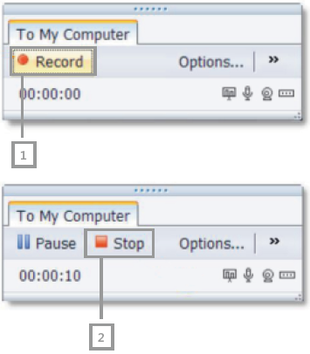
TIP: If you want to invite additional people to the meeting after it starts, in the Live Meeting window, click Meeting, click Invite, click By E-mail,
Record a meeting
To record a meeting
Before recording your meeting in Microsoft® Office Live Meeting, in the Recording pane, click Options to access the Personal Recording Options dialog box. Choose where you want to save your recording and what you want to record.
To record your meeting, in the Recording pane, click Record.
To save your recording, click the Stop icon, and choose Save Recording.
To check the status of your recording, click Start, click All Programs, click Microsoft Office Live Meeting, and then click Microsoft Office Live Meeting Recording Manager.

Slide 45
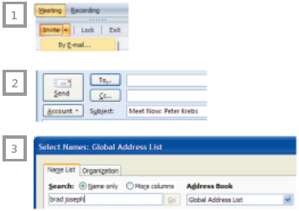
TIP: If you want to invite additional people to the meeting after it starts, in the Live Meeting window, click Meeting, click Invite, click By E-mail,
Find people during a Live Meeting
Find and invite people in Microsoft® Office Live Meeting
To find a person or people to invite during a Live Meeting, click Meeting, click Invite, and then click By E-mail. An Outlook invitation window will open.
In the Outlook invitation window, click To.
Type the name of the person you want to find in the Search box of the Global Address List.
TIP: To invite a person outside the company, you will need to know the person’s e-mail address. If necessary, you can call the person to get their e-mail address.

Slide 46
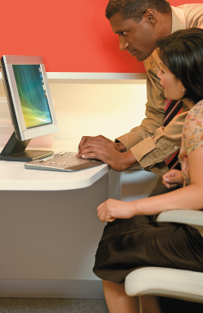
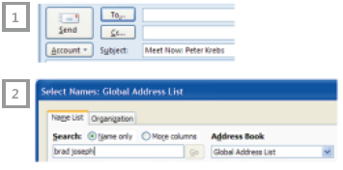
TIP: If you want to invite additional people to the meeting after it starts, in the Live Meeting window, click Meeting, click Invite, click By E-mail,
Find people when starting a Live Meeting
Find people when you start a meeting in Microsoft® Office Live Meeting
When starting a Meet Now or Scheduled Live Meeting, click the To button in the Outlook invitation.
Type the name of the person you want to find in the Search box of the Global Address List window.
TIP: To invite a person outside the company, you will need to know the person’s e-mail address. If necessary, you can call the person to get their e-mail address.

Slide 47
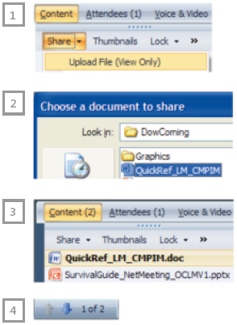
TIP: If you want to invite additional people to the meeting after it starts, in the Live Meeting window, click Meeting, click Invite, click By E-mail,
Upload files to Live Meeting
If you scheduled or started a Meet Now meeting in Microsoft® Office Live Meeting, or if you are a Presenter in the meeting, you can upload Microsoft Office PowerPoint®, Word, Excel®, Visio® or, video files. It’s best to upload files before scheduled meetings so that content is ready for presentation when the meeting starts.
In the Live Meeting window, click Content, click Share, and then click Upload File (View Only).
In the Choose a document to share dialog box, select a file to upload, and then click Open to upload the file.
To present a file during the meeting, click the file name in the Content pane.
Use the Previous or Next buttons at the bottom of the Live Meeting window to navigate through the slide presentation or document.
TIP: When you upload files, they are converted to the Live Meeting format. Sometimes this format does not support the functionality of the program used to create the file. For example, uploaded Word files will not display revision marks. If you need the full functionality of a program, use the Share a Program or Share Your Desktop option.

Slide 48
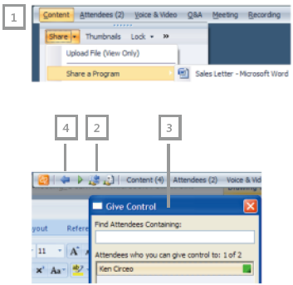
TIP: If you want to invite additional people to the meeting after it starts, in the Live Meeting window, click Meeting, click Invite, click By E-mail,
Share a program in Live Meeting
If you require the full functionality of a program during a meeting in Microsoft® Office Live Meeting, you should choose the Share a Program option. Generally it is a best practice to share a program rather than your desktop during a Live Meeting. You should use the Share Your Desktop option only when you need to share multiple applications.
In the Live Meeting window, click Content, click Share, point to Share a Program, and then select the program you want to share.
To give control to a participant or participants, click the Give Control button.
In the Give Control dialog box, select a participant’s name, click OK, and then click Yes. To take control, the participant clicks OK when prompted. To get control back, click the Take Control button (the same button as Give Control).
To end sharing a program, click the End sharing and return to Live Meeting button.

Slide 49
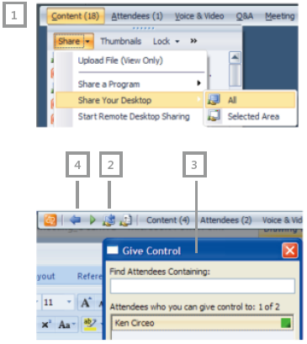
TIP: If you want to invite additional people to the meeting after it starts, in the Live Meeting window, click Meeting, click Invite, click By E-mail,
Share your desktop in Live Meeting
If you need to share multiple programs working together or show your entire desktop in Microsoft® Office Live Meeting, you should choose the Share Your Desktop option. Generally it is a best practice to share a program rather than your desktop during a Live Meeting.
In the Live Meeting window, click Content, click Share, point to Share Your Desktop, and then select All.
To give control to a participant or participants, click the Give Control button.
In the Give Control dialog box, select a participant’s name, click OK, and then click Yes. To take control, the participant clicks OK when prompted. To get control back, click the Take Control button (the same button as Give Control).
To end sharing a program, click the End sharing and return to Live Meeting button.

Slide 50
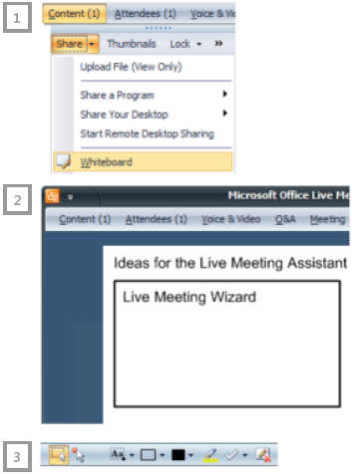
TIP: If you want to invite additional people to the meeting after it starts, in the Live Meeting window, click Meeting, click Invite, click By E-mail,
Share a Whiteboard in Live Meeting
A Whiteboard is a blank image slide upon which you can draw, add text and stamps, and highlight information by using the annotation tools in Microsoft® Office Live Meeting. For example, if you want to quickly create a flow chart to illustrate a point, insert a Whiteboard slide and then use the annotation tools to draw squares and lines.
In the Live Meeting window, click Content, click Share, and then click Whiteboard.
The Whiteboard slide loads in the Live Meeting window.
Use the Annotation toolbar at the bottom of the Live Meeting window to add text, shapes, or annotations to the Whiteboard slide.

Slide 51
TIP: If you want to invite additional people to the meeting after it starts, in the Live Meeting window, click Meeting, click Invite, click By E-mail,
Etiquette when joining a meeting
When you join a Microsoft® Office Live Meeting, follow this basic etiquette.
• Be respectful of your colleagues’ time. Log in to the meeting a few minutes early and check your audio/video setup to ensure your devices are properly configured.
• Use a wired network. Using any wireless network will affect your audio quality, and, if you are speaking, will degrade the meeting experience for all meeting attendees.
• Set up and test your device before you begin participating. Run the audio setup to ensure that your audio device is set as the microphone (this setting often defaults to your webcam microphone if one is plugged in).
• Use one of the recommended audio devices from http://technet. microsoft.com/en-us/office/ocs/bb970310.aspx. Many current laptop mics, speakers, or webcam mics may introduce echo or audio issues, causing distractions or drawing unwanted attention toward you, thus ruining the meeting experience for others. It is important to note that the creator of audio issues rarely hears them.
Mute your audio unless you are
speaking. This will avoid introducing
any unnecessary typing sounds or other
background noise. If you have a camera
plugged in and are not muted, the
slightest noise will cause your video to be
shown as the active speaker.
• Find a quiet space to work. If possible,
join the meeting from a place free of
loud background noise, otherwise, each
time you speak, the other attendees will
find it difficult to hear you.

Slide 52
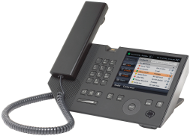
Setting up your UC Desk Phone
Unpack the UC Desk Phone and connect handset.
• Plug in to Ethernet jack on the wall.
• Plug in power supply if required.
• Calibrate the touch screen.
• Your PC plugs into your UC Desk Phone for Ethernet connectivity.
Note: If there are multiple UC Desk Phone devices in an office, connect them in sequence (daisy chain).
Log in to the device—use your full e-mail address (Domain\Alias) and Corporate Network Password.
• Not the same as your Exchange Unified Messaging password.
• Set up fingerprint reader or PIN to unlock device.
Try making a few calls.

Slide 53
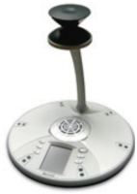
Start a meeting with Microsoft® RoundTable™
Connect LAN cable to computer; disable computer wireless.
Connect meeting room AV cable to computer.
Connect Microsoft® RoundTable™ USB cable to computer.
Launch Microsoft Office Live Meeting 2007.
Project the Microsoft® RoundTable™ session via the meeting room projector.
Prevent in meeting room attendees from viewing all Live Meeting video via their computer as this reduces bandwidth usage.
All attendees should mute their microphones when not speaking to prevent echo.

Slide 54
Learn more at: http://www.microsoft.com/communicationsserver/enduser/tutorials/
Send feedback to: trainuc@microsoft.com

